Slide 1
Braver Angels
Lower Susquehanna Alliance – Pennsylvania (BALSA)
Ted B. Borek & Terry Webb Presenters
Willow Valley Democratic Club, April 29, 2025
To learn more about upcoming Braver Angels programs, go to: braverangels.org/events
Notes:
Welcome to the Basic Presentation about Braver Angels called, “Becoming Braver Angels: Depolarizing the United States.”
As you review the presentation, please take into consideration the following points:
BACKGROUND INFORMATION ON SLIDE DEVELOPMENT
These slides and script have been carefully vetted by various entities, including national leaders and special interest groups, within Braver Angels. Although you may make changes based on your audience and needs, it is highly recommended that you use these slides and verbiage to ensure you’re communicating the appropriate messages.
The presentation is based on the Monroe’s Motivated Sequence described in the Ambassador Toolkit.
It should take approximately 20-25 minutes to give this presentation. There is a shorter version available. NOTE: Although there are 45 slides, you may only spend a few seconds on some, so total presentation time is not an issue.
VISUAL AID/SLIDE DESIGN
The slides are designed to be very simple and clear, while still providing bullet points for those who are used to having informative slides. Studies show that “less is more” and, in fact, the more words on a slide, the more difficult it is for your audience to pay attention.
5 Tips To Making an Awesome PowerPoint Presentation
The slides are also designed to be appropriate for those with visual impairments. That is why they are dark blue print on a white background.
How to Make Your Presentations Accessible to All
Note the branding on each page (subtle but there) and the general consistency among slides.
There are some slides that have animation (flying bullets) to add visual interest. These are done when it’s expected you will want to highlight each point. Others, without animation, can be discussed in more general terms.
If you make changes or add a visual, make sure they are very clear and not blurry. Admittedly, the “Our Story” slide violates this somewhat; but there are no high-quality photos with high resolution available. (If you have one, please send it to lbeck@braverangels.org.)
The video in Slide 21 is added as a change of pace; it is not included in the 20-25 minute estimate for this presentation.
Referenced material is shown on slides in a very general, non-academic manner; this is purposeful. If you are speaking to an academic audience, you may want to include academic citations.
Font sizes are consistent throughout and are 72 points and bold for headings; 48 points and not bolded for other text. (There are some places where this is “fudged” a few points due to the amount of material on the slide.
GOOGLE SLIDES
IF YOU MAKE CHANGES, YOU WILL NEED TO MAKE A COPY OF THIS DOCUMENT: Please see the above and carefully consider any changes you make. If you DO make changes, ensure you:
Are consistent in look and feel. Do not just cut and paste some of your slides from a different presentation.
Avoid using text that is any smaller than existing point sizes.
Use as few words as possible.
Use clear and easy-to-see visuals.
For portability reasons, the slides are created in Google Slides. Google Slides operates similarly to PowerPoint.
To make a copy of the slides for your own use, click, “File” → “Make a copy” → “Entire Presentation”
If you want to download these slides into PowerPoint, click “File” → “Download.” From there, choose “Microsoft PowerPoint (.pptx)” as your option. (You have other options as well.)
DELIVERY
While there is a script, you are STRONGLY encouraged not to read the script. Instead, become familiar with the bullet points on the slides and in the script and deliver extemporaneously–that is where you are practiced and prepared, but not reading or presenting memorized information.
QUESTIONS?
If you have any questions or concerns about these slides, please contact lbeck@braverangels.org.

Slide 2
Origin Story of Braver Angels
The first workshop: A post 2016 election decision by David Blankenhorn, David Lapp, and Bill Doherty to bring together 10 Hillary Clinton supporters and 10 Donald Trump voters for 13 hours over a weekend in South Lebanon, OH, in December 2016. It was powerful and successful, and we decided not to stop.
National visibility: In March 2017, a National Public Radio call-in program. Outpouring of interest: come to our community!
More workshops: An April weekend workshop in Ohio, then two 3-hour versions in Minnesota in May and June 2017. This worked! Development of a skills workshop.
The bus tour, July 4-25, 2017: 9 states, 13 towns doing workshops; local people put us up in their homes; recruited participants, found sites.
David Blankenhorn, founder and former director: “We have lightning in a bottle!”
Notes:
And then tell you more about Braver Angels, including how our organization views polarization and what we can do about it.

Slide 3
Braver Angels Has Grown
In only 7+ years
there are now 15,160+ members
in 116 Alliances
and 387 BA NETWORK Organizations.
BA members have conducted
5032+ events
involving 62,460+ participants. 4/15/2025
To learn more about Braver Angels go to: braverangels.org/events.
Notes:
And then tell you more about Braver Angels, including how our organization views polarization and what we can do about it.

Slide 4
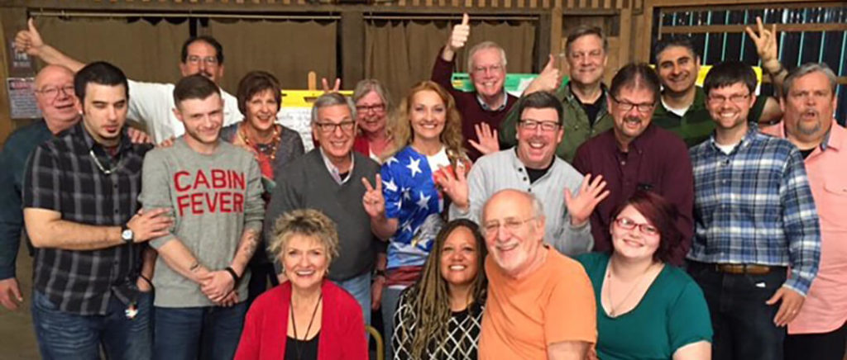
Our Story
Notes:
How did we begin? This is a picture taken at our very first workshop.
Based on concepts taken from marriage counseling, of all places, the organization started just after the 2016 election, bringing “reds” and “blues” together to help them better understand the other side in an effort to reduce polarization.
Braver Angels was originally founded as “Better Angels,” based on a line from Lincoln’s first inaugural speech, appealing to the “better angels of our nature.” As our mission and membership has changed and grown, so has our name. We now emphasize the need to be brave and show the courage needed to address our country’s divide.
NOTE to Presenters: You can check out this link on the BA website for more information about the founding of Braver Angels.

Slide 5
The Braver Angels Way
We state our views freely and fully, without fear.
We treat people who disagree with us with honesty, dignity, and respect.
We welcome opportunities to engage those with whom we disagree.
We believe all of us have blind spots and none of us are not worth talking to.
We seek to disagree accurately, avoiding exaggeration and stereotypes.
We look for common ground where it exists and, if possible, find ways to work together.
We believe that, in disagreements, both sides share and learn.
In Braver Angels, neither side is teaching the other or giving feedback on how to think
or say things differently.
Notes:
And then tell you more about Braver Angels, including how our organization views polarization and what we can do about it.

Slide 6
To Meet The Challenge of Polarization
Social or “affective” polarization characterized by:
Othering: Seeing people who differ politically as essentially different or alien
Aversion: Holding dislike and distrust for them as persons
Moralizing: Seeing them as bad people
Ref. Finkel, E.J., et al. (2020), “Political Sectarianism in America.” Science, 370, 533-536
Notes:
And then tell you more about Braver Angels, including how our organization views polarization and what we can do about it.

Slide 7
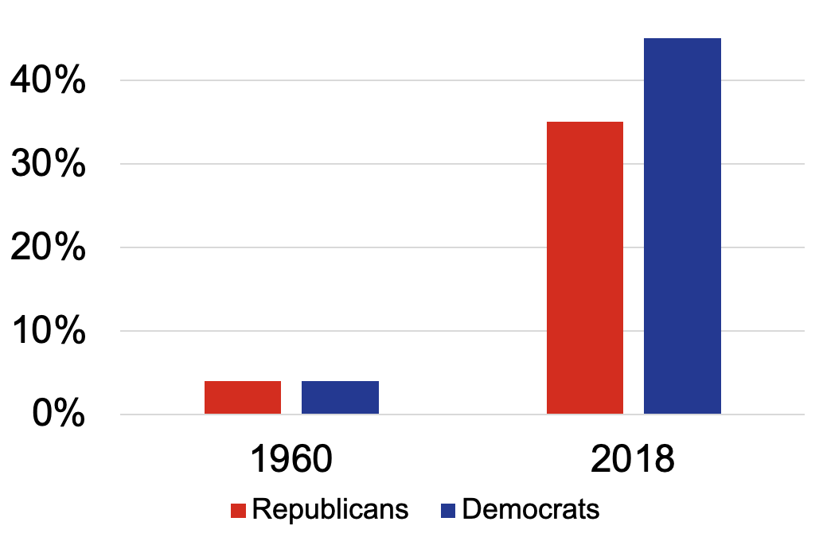
The Challenge of Polarization
Example of increase
In 1960, only 5% of Americans were uncomfortable with an “inter-party marriage.”
Now about 40% of Americans would
be unhappy with this.
Notes:
And then tell you more about Braver Angels, including how our organization views polarization and what we can do about it.

Slide 8
The Challenge of Polarization
Polarization has now entered nearly every sector of life
Family
Work
Politics
Civic organizations
Religious congregations
Schools
Colleges/universities
Notes:
And then tell you more about Braver Angels, including how our organization views polarization and what we can do about it.

Slide 9
Six Main Areas of National Programming
Field Operations and Grassroots Leadership (growing alliances)
Braver Network - brings organizations together to bridge the divide
3. Braver Politics – red/blue and depolarizing workshops at local, state and federal levels of government
4.Debates - college, national, and community
5. Braver Media - podcasts, social media, news outlets
6. Convention - bringing us all together
Notes:
And then tell you more about Braver Angels, including how our organization views polarization and what we can do about it.

Slide 10
Examples of Debate Colleges
Arizona State University
University of California-Berkeley
American University
University of Connecticut
Mississippi State University
Texas Woman’s University
Texas Tech University
Georgia State University
Yale University
Allegany College of Maryland
Virginia Military Institute
University of Texas-Austin
Duke University
Notes:
And then tell you more about Braver Angels, including how our organization views polarization and what we can do about it.

Slide 11
Examples of Debate Topics, College
Resolved: American media undermines free speech and fair elections.
Resolved: The U.S. should implement more restrictive gun laws to reduce crime.
Resolved: Immigration laws should be changed to allow for quicker citizenship.
Resolved: There should be term limits for Supreme Court justices.
Resolved: Schools should not teach about racism and critical race theory.
Notes:
And then tell you more about Braver Angels, including how our organization views polarization and what we can do about it.

Slide 12
Examples of Debate Topics, BALSA
Critical Race Theory
Social Media Censorship
Book Bans in Public Schools -
Restricting Access to Fire Arms
Abortion
Eliminate Tax Incentives for Electronic Vehicles
We Need the Dept. of Gov’t Efficiency (DOGE) -
Climate Change
Notes:
And then tell you more about Braver Angels, including how our organization views polarization and what we can do about it.

Slide 13
Examples of Debate Topics, Nat’l
Artificial Intelligence
America needs changes Trump promises
Republicans are the party of the working class
Trump’s First 100 days, crisis or leadership -
End Birthright Citizenship
Foreign Policy
Executive Orders
DEI
FISHBOWL: HOPES and CONCERNS of Trump’s Election
Notes:
And then tell you more about Braver Angels, including how our organization views polarization and what we can do about it.

Slide 14
Trustworthy Elections Workshops
Trustworthy Elections
A polarized issue for both Republicans and Democrats
Braver Angels conducted 26 Common Ground workshops from 2020-2023
Over 194 participants from 27 states – evenly balanced, Red and Blue – worked to find solutions to voter concerns
See the full report at https://braverangels.org/trustworthy-elections/
Notes:
And then tell you more about Braver Angels, including how our organization views polarization and what we can do about it.

Slide 15
Trustworthy Elections Report
The Guiding Principles of the Report:
Voting should be easy. Cheating should be hard.
Every citizen should have an equal say in who will govern them; this is done through free and fair elections.
The American government will fail if candidates refuse to accept any outcome other than victory.
See the full report at https://braverangels.org/trustworthy-elections/
Notes:
And then tell you more about Braver Angels, including how our organization views polarization and what we can do about it.

Slide 16
Trustworthy Elections Report
The Workshop Process
As they addressed values, concerns, and solutions,
the Red-Blue-balanced groups arrived at
727 unanimously agreed-on Points of Agreement
and 23 specific solutions.
See the full report at https://braverangels.org/trustworthy-elections/
Notes:
And then tell you more about Braver Angels, including how our organization views polarization and what we can do about it.

Slide 17
Trustworthy Elections Report
The workshop proposed 23 solutions grouped into 7 topics:
Fair and equal access to voting
Verifiable voter identity and eligibility
Transparency and accountability
Redistricting - gerrymandering
Confidence in vote counting
Safety and security in the election process
Peaceful transfer of power
See the full report at https://braverangels.org/trustworthy-elections/
Notes:
And then tell you more about Braver Angels, including how our organization views polarization and what we can do about it.

Slide 18
Report Distribution
BA sent a team of six people to the National Association of Secretaries of State in January 2025
BA representatives shared the Trustworthy Elections Report with Secretaries of State and staffs including every state (27) where BA had conducted a TE Workshop
BA Alliances and representatives continue to reach out to public officials and service organizations to explain the TE Report
Notes:
And then tell you more about Braver Angels, including how our organization views polarization and what we can do about it.

Slide 19
What to do about Polarization?
Agreeing to Disagree Agreeably Sunday School Program
Piloted in January, 2020
at Blossom Hill Mennonite Church
Discovered Braver Angels – workshops online during Covid Pandemic
Notes:
And then tell you more about Braver Angels, including how our organization views polarization and what we can do about it.

Slide 20
Mission
BA brings Americans together in workshops to bridge the partisan divide.
Notes:
Here’s the mission of Braver Angels: Braver Angels brings Americans together to bridge the partisan divide and strengthen our democratic republic.

Slide 21
Our
Own
Party
The
Other
Party
Notes:
Over the last few decades our affect--our emotions and attitudes--towards our own party has stayed relatively similar or even gotten better (according to the 2019 Annual Review of Political Science).
(Click) But our views of the other party have gotten much worse.
NOTE to Presenter: Here is more information about the political divide in our country if you want to reference it. However, we suggest you not go “overboard” with a lot of data–first, because of time and secondly, because we want to focus on “the good” not the polarization that many Americans already know about. (The bottom of the link has information about “the desire and hope for change.”)
(FYI–David Blankenhorn sits on the Board of Advisors for the Listen First Project, from which the link comes.)
You may also want to read this article from Jonathan Haidt, who serves on the BA board: Why the Past 10 Years of American Life Have Been Particularly Stupid

Slide 22
Rule
Speakers on topics for and against topics such as Immigration, Abortion, Guns, Climate
Change, Race and Gender
.
Notes:
Our rule seeks to have red and blue leaders at every level of the organization.
Having said this, we admit that our organization currently has more Blues than Reds and are actively seeking more Red participation (and we’ll talk about that a little bit more when we get to the discussion of our special interest groups).

Slide 23
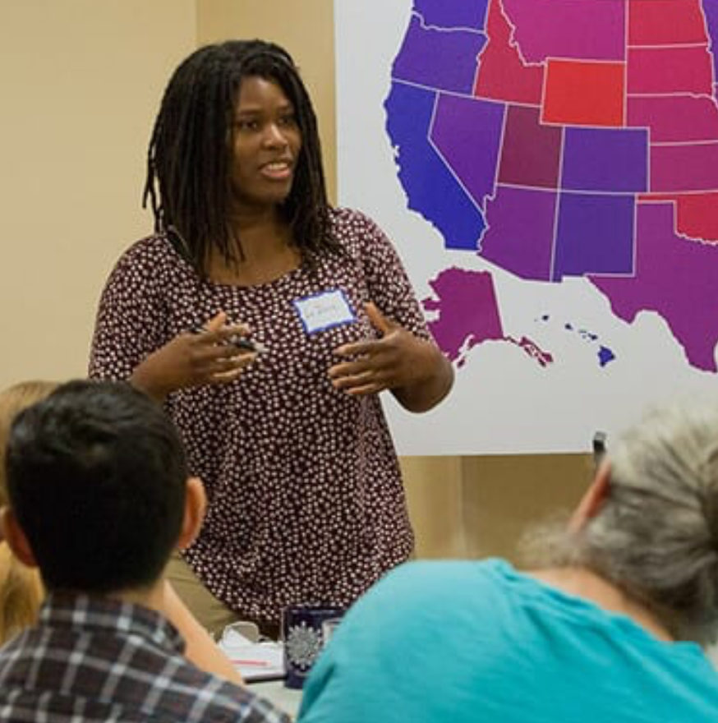
Workshops Offered Most Frequently
Depolarizing Within (self-change)
Disagreeing Better (skills-building)
Red-Blue Workshop (engagement)
Families and Politics (self-change)
Public Policy and Race (skills-building)
Common Ground (engagement)
Notes:
And then tell you more about Braver Angels, including how our organization views polarization and what we can do about it.

Slide 24
Pledge
We try to understand the other side’s point of view.
Notes:
We have a pledge that includes the phrase “As individuals, we try to understand the other side’s point of view, even if we don’t agree with it.”
Admittedly, that’s difficult and so we recognize the need to listen and then try to understand.

Slide 25
Core Values
Respect
Humility
Honesty
Responsible Citizenship
Notes:
In all, it comes down to our core values:
Respect–We will talk about our fellow citizens on the other side with respect for their intelligence and good will. We will avoid characterizing them as deserving of our disdain or pity.
Humility–We will talk about our own side with the knowledge that our leaders are not perfect and that our current polity solutions are not complete answers to our nation’s complex problems.
Honesty–We will allow people to feel what they are feeling. We will not ask them to hide their satisfaction or grief regarding current events.
Responsible Citizenship–We will emphasize that it’s up to all of us, we-the-people, to depolarize our politics and meet our common challenges.

Slide 26
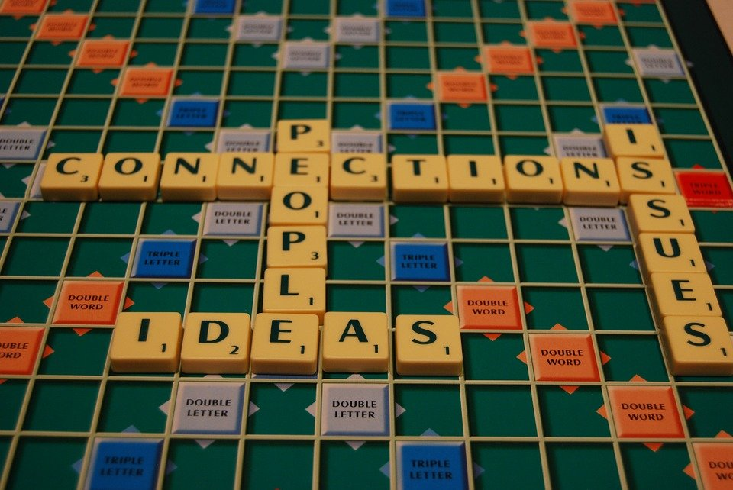
Goal is NOT to Change Views on Issues
Notes:
Here’s something important! Our goal is NOT to try to make people change their views on the issues. That rarely happens--especially if there’s not already a relationship of trust between the people talking.

Slide 27
Braver Angels Lower Susquehanna Alliance
(BALSA)
From One County to Five
Formed in January 2021 as the Lancaster Alliance
Held our 1st public event – a debate on whether Lancaster County should create a Public Health Department – 50 people
Expanded and changed our name in the summer of 2022 due to interest from folks in the surrounding area. BALSA now includes 4 more counties: Cumberland, Dauphin, Lebanon, and York
Melissa Gizzi, Red Co-Chair Ron Chadwell, Blue Co-Chair
Notes:
And then tell you more about Braver Angels, including how our organization views polarization and what we can do about it.

Slide 28
Braver Angels Lower Susquehanna Alliance
(BALSA)
Continued Growth
In 2024, we engaged over 550 people at our events
The alliance now has over 138 dues-paying members and over 550 newsletter subscribers
3/27/25
Melissa Gizzi, Red Co-Chair Ron Chadwell, Blue Co-Chair
Notes:
And then tell you more about Braver Angels, including how our organization views polarization and what we can do about it.

Slide 29
→ Attend One of Our Upcoming BALSA Events
Sep 12 from 7-8:30 pm Braver Angels Documentary and Discussion
Sep 19 from 6-9:00 pm Depolarizing Within Workshop (in person)
St. Paul Evangelical Lutheran Church, 200 W. Orange St.
Melissa Gizzi, Red Co-Chair Ron Chadwell, Blue Co-Chair
Notes:
And then tell you more about Braver Angels, including how our organization views polarization and what we can do about it.

Slide 30
Upcoming National Programs
May 1, 2025, 8pm ET, Debate: Resolved President Trump is Making America Great Again. Register at Newsletter@braverangels.org
May 20, 2025, 8pm ET, Debate: Resolved Social Media Companies Should fact-check users’ posts. Register at Media@braverangels.org
For more debates and programs visit: https://braverangels.org
Notes:
And then tell you more about Braver Angels, including how our organization views polarization and what we can do about it.

Slide 31
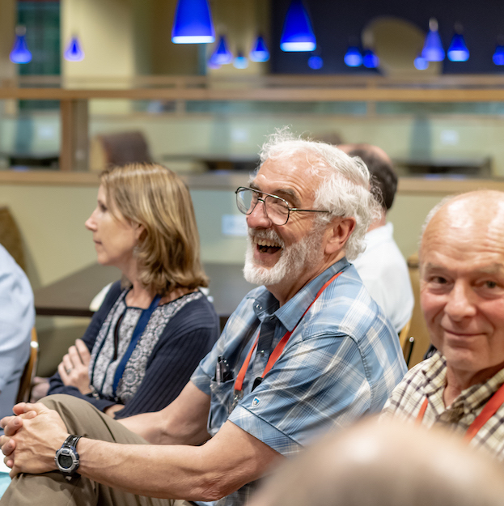
Other Programs
1:1 Conversations
Braver Faith
Mental Health Professionals
Braver Angels Musicians
Pair Up.Bravely
Experience.Bravely
Notes:
We offer many other programs to build relationships and continue the conversation from workshops, including:
1:1 conversations that are structured, unmoderated discussions. They can be across red/blue, urban/rural, racial/ethnic or generational differences.
Braver Angels debates are a collaborative search for the truth, with everyone invited to speak on difficult issues facing the country.
And we also have book/movie discussions, red/blue pairs, local alliances and, yes, even songwriting contests!

Slide 32
National Conventions
2023 Convention in Gettysburg, PA
2024 in Kenosha Wisconsin:“American Hope Campaign”
BA programs, podcasts, debates and films
to help reduce political polarization
and find common ground on controversial topics
during this election year and beyond.
To learn more about the convention, go to: braverangels.org/2024-convention/
Notes:
And then tell you more about Braver Angels, including how our organization views polarization and what we can do about it.

Slide 33
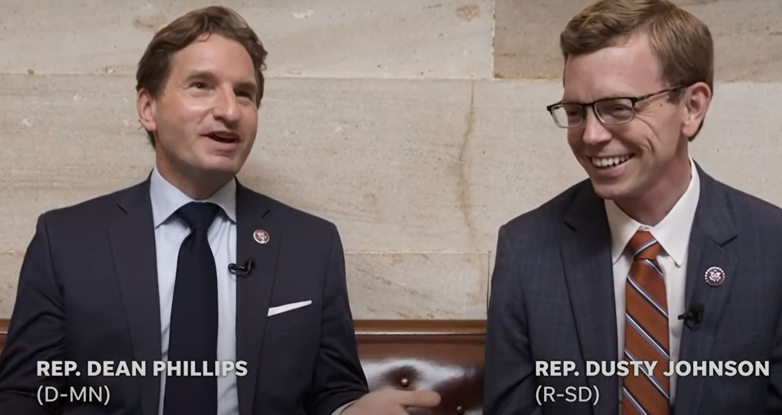
Braver Politics
Goal: Work with legislators and their staffs
Goal: increase trust
Connect citizens
Notes:
I want to take a minute to discuss a specific initiative that we hope will have a far-reaching impact on our country. Braver Angels recently started an initiative called “Braver Politics” designed to create an environment in which we use Braver Angels grassroots organizers to provide evidence-based, citizen-led opportunities for (Click) officials and their staff across the country–at the local, state and federal level–to find the skills and make commitments to work together productively across the partisan divide.
(Click) The end goal is an America where citizens trust elected officials, voters in both parties trust elections, and (Click) our political institutions reflect the spirit of citizenship and common purpose.
The photo represents Rep Dean Phillips, a Democrat from Minnesota, and Rep. Dusty Johnson a South Dakota Republican, who are two of our most prominent supporters.
NOTE to presenters: You can find more information about Braver Politics here. You may also want to watch this video where the representatives discuss their attitudes towards bipartisanship and depolarization.

Slide 34
Current National Directions
Consensus from Kenosha to address IMMIGRATION ISSUES in 2025-2026
Debates on Trump’s Agenda
Continue to build coalitions
Notes:
And then tell you more about Braver Angels, including how our organization views polarization and what we can do about it.

Slide 35
Time for Q&A
?
Notes:
And then tell you more about Braver Angels, including how our organization views polarization and what we can do about it.

Slide 36
How might you get Involved
How can we interest Republicans, especially MEGAs?
Are Debates or Workshops more important for BA?
In midst of Constitutional Crisis what is the priority?
Could Dems sponsor a debate? Or a workshop?
See handout
Notes:
And then tell you more about Braver Angels, including how our organization views polarization and what we can do about it.

Slide 37
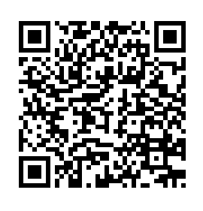
Help Make a Difference
Braverangels.org
Scan QR code and read handout
Text BA to 66866
Scan for Take Home Tips!
Notes:
We’ve gone through a lot of information today and I hope you want to learn more. Please take out your phones and scan the QR code for some additional tips and the opportunity to get our weekly newsletter. You can also learn more by going to our website or texting BA to 66866 to become a member.
NOTE: These items all serve separate functions:
Strongly encourage participants to scan the QR code for take-home tips and to subscribe to our newsletter. (This supports our initiative to grow membership and track participants that may not otherwise be tracked.
The website will provide general information (but offers no way to track them or provide continued information.)
The text is simply if a person knows they want to join.

